Slide 1
Darwin’s Theory of Evolution

Slide 2
By the end of this lesson, you should be able to:
• | Understand Darwin’s Theory of Evolution.
• | Understand the concepts of natural selection and common ancestry.

Slide 3
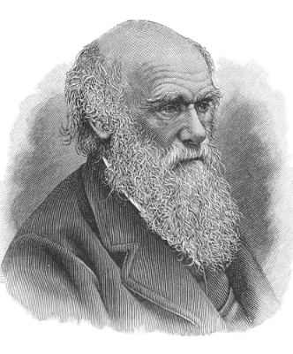
In 1809, a young scientist by the name of Charles Darwin was born. He made a very important contribution to biology!
Even when he was just a boy, Darwin had a keen interest in nature, and loved to collect insects.

Slide 4
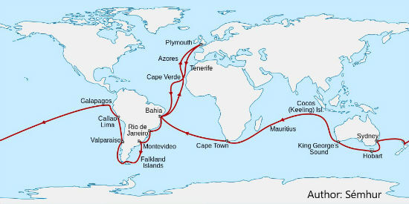
When Darwin was just 22, he joined the crew of a ship called the HMS Beagle.
He worked as the ship's naturalist. His job was to observe and collect specimens of plants, animals and rocks from the places they travelled.
The voyage lasted almost 5 years!

Slide 5
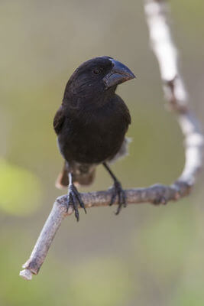
During his travels, Charles Darwin became interested in the finches of the Galapagos Islands.

Slide 6
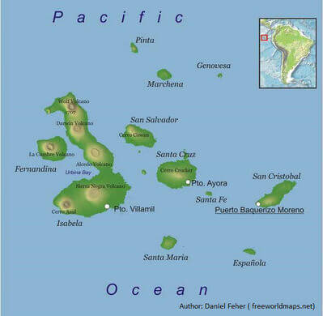
Each island in the Galapagos had a different environment. Some were warm and humid, and others were cooler.
Each island had different available food sources.

Slide 7
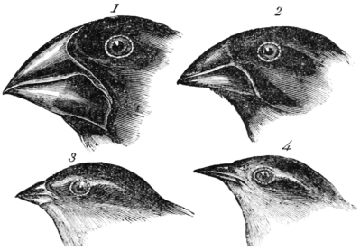
The finches on each island were different too.
Their beak shapes seemed to differ according to what they ate. Some finches had narrow, sharp beaks to probe the ground for insects. Others had large, broad beaks for crushing fruit and seeds!
1. | Geospiza magnirostris | 2. | Geospiza fortis
3. | Geospiza parvula | 4. | Certhidea olivacea

Slide 8
Based on these observations, Darwin proposed that all the different types of finches had descended from one common species.
He proposed that this common species had been moulded by the different island environments and adapted to the different food sources. This explained their different beak shapes!

Slide 9
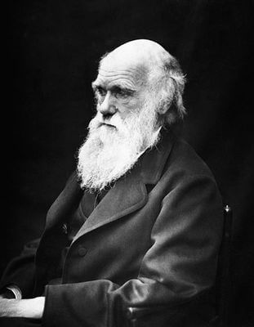
Charles Darwin coordinated with another scientist, Alfred Wallace, who had noticed that monkey species differed on opposite sides of a river in the Amazon.
Together, they proposed a theory that all species arose from a common ancestor, and changed through the natural selection of traits that increased the organism's chance of surviving and reproducing.
This was the theory of evolution by natural selection!

Slide 10
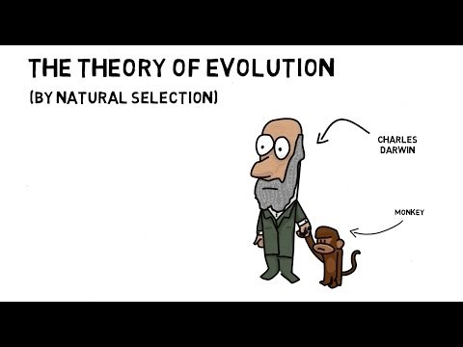

Slide 11
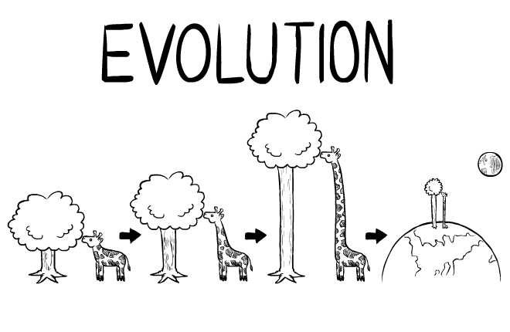
Evolution is the process of genetic change in a species over many generations through genetic inheritance, sometimes resulting in the formation of a new species.
A generation is the time between the birth of one organism, and the point in time when that organism produces its own offspring.

Slide 12
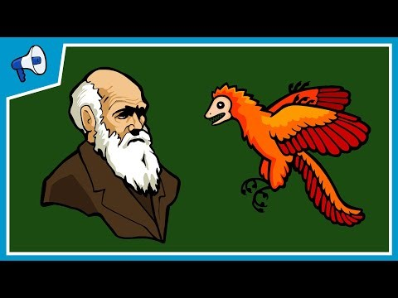

Slide 13
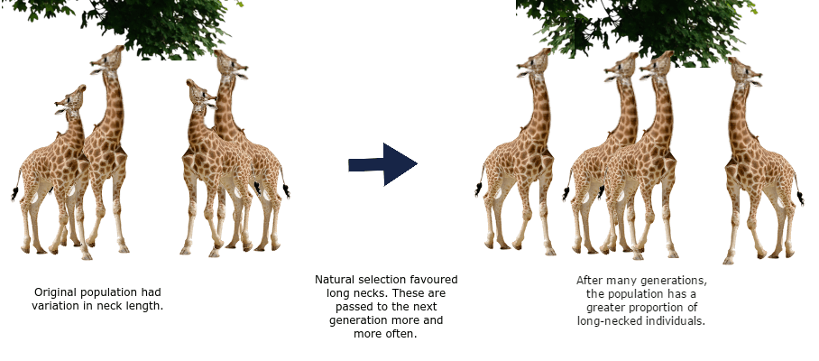
Natural selection is the increase or decrease in the frequency of certain alleles within a population due to pressures.
These pressures may be biotic (from living organisms) or abiotic (from the non-living environment).
Organisms better-suited to their environment are more likely to survive, reproduce and pass their genes on. After many generations, natural selection may alter the genetic makeup of entire populations!

Slide 14
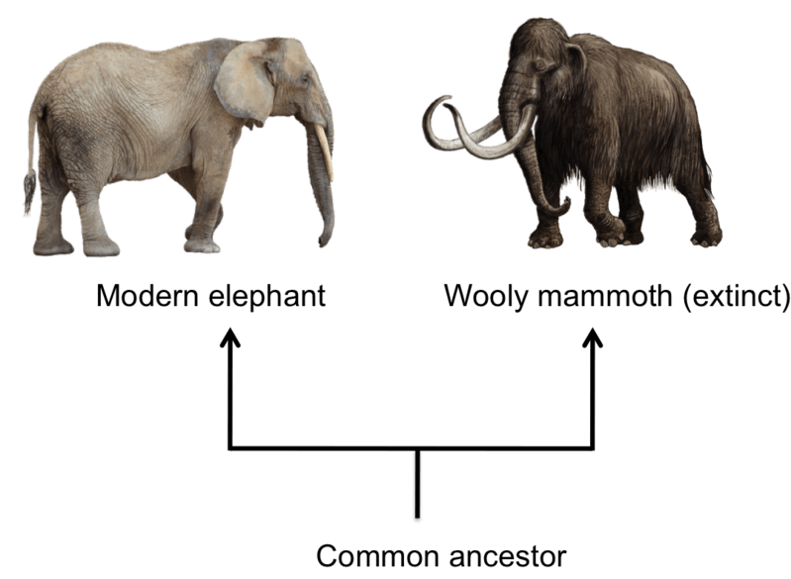
Darwin's theory of evolution states that species that are similar must be closely related to each other, or descend from a common ancestor.
Descent from a common ancestor can take species thousands or millions of years.

Slide 15
A common ancestor is an ancient species from which multiple present day species are descended.
This indicates that those present day species are related, almost like cousins!

Slide 16
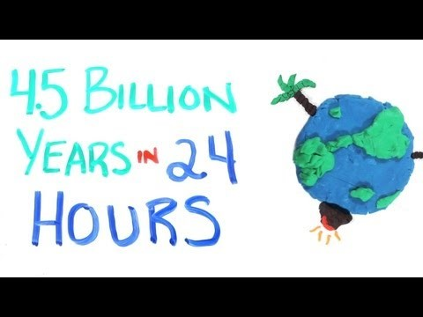

Slide 17
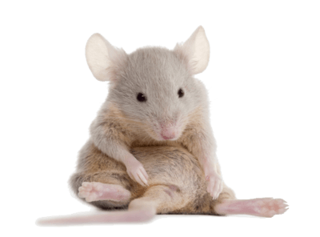
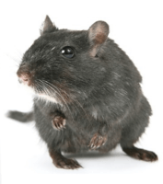
Let's go through an example of natural selection!
Imagine a population of mice. Half of the mice are dark grey, and half are light grey.
Unfortunately, these mice are just tasty morsels to hungry owls, who come out at night to hunt.
Light grey mice are easier for owls to see. They get snatched up more often than dark grey mice do!

Slide 18

Because light grey mice are more susceptible to becoming snacks, fewer light grey fur genes remain in the gene pool each night.
The dark grey fur allele, therefore, is selected for by nature.
Over time, the population will only comprise of dark grey mice, as these are the only ones that will survive to reproduce.

Slide 19
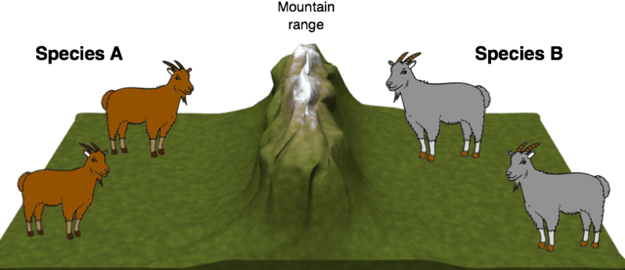
It can take much longer for a new species to evolve from a population.
A population is only truly a new species when it can no longer interbreed with the old species and produce viable offspring.

